Slide 1

JSE COACHING
A COMPREHENSIVE GUIDE BY DR. JOHN SPENCER ELLIS
Autophagy and Longevity
How Men Over 40 Can Extend Lifespan
The complete evidence-based guide to activating cellular self-renewal through fasting, exercise, nutrition, and lifestyle — the specific longevity intervention Yoshinori Ohsumi won the 2016 Nobel Prize for discovering.
Dr. John Spencer Ellis, age 57
Dr. John Spencer Ellis, EdD | Age 57
Leading Men's Longevity Expert & Health Coach
Las Vegas, Nevada | johnspencerellis.com

Slide 2
About This Comprehensive Presentation
The definitive men's longevity resource on autophagy
This 55-slide presentation from Dr. John Spencer Ellis, leading men's longevity expert, delivers evidence-based answers to 20 essential questions about autophagy — the cellular self-renewal process for which Yoshinori Ohsumi won the 2016 Nobel Prize in Physiology or Medicine. Each question receives a dedicated slide with a keyword-rich headline, comprehensive educational answer, and three color-coded takeaway boxes.
Autophagy is not another trending health topic. It is one of the most consequential biological processes affecting men's longevity, healthspan, hormone optimization, and cognitive function after 40. Understanding it — and knowing how to activate it deliberately — separates men who age well from men who accept unnecessary decline.
Every question is answered with actionable specificity for men over 40.
Dr. John Spencer Ellis | Autophagy & Longevity for Men Over 40 | 2 of 55

Slide 3
The 20 Questions Answered
The complete autophagy education roadmap
1
What is autophagy and why does it matter
2
Why autophagy declines after 40
3
How autophagy repairs cells
4
Autophagy-longevity relationship
5
How intermittent fasting activates autophagy
6
How long to fast for autophagy
7
Best fasting methods for autophagy
8
Foods and habits that support autophagy
9
Habits that inhibit autophagy
10
Proven autophagy health benefits
11
Autophagy and disease prevention
12
Autophagy for brain and cognition
13
Autophagy for energy and muscle
14
Exercise and autophagy
15
Supplements that support autophagy
16
Can there be too much autophagy
17
Who should avoid extended fasting
18
Building a sustainable autophagy plan
19
Daily habits to maximize autophagy
20
The most important takeaways
Dr. John Spencer Ellis | Autophagy & Longevity for Men Over 40 | 3 of 55

Slide 4
Executive Summary: Why Autophagy Matters
The core message every man over 40 needs to understand
Autophagy is your body's built-in cellular renewal system. Damaged proteins get recycled. Dysfunctional organelles get replaced. Cellular debris gets cleared. This process is essential for hormone production, cognitive function, muscle repair, cardiovascular health, and immune function. It is one of the most important biological processes determining how well men age.
The problem: autophagy naturally declines after 40 — significantly. The solution: specific lifestyle interventions can dramatically restore autophagy activity. Intermittent fasting, structured exercise, quality sleep, specific foods, and hormetic stressors all activate autophagy through documented mechanisms. Men who understand and apply these interventions produce measurable healthspan extension across the second half of life.
Restore autophagy, and every other longevity intervention becomes more effective.
Dr. John Spencer Ellis | Autophagy & Longevity for Men Over 40 | 4 of 55

Slide 5
About Dr. John Spencer Ellis
Leading men's longevity expert with 33 years of experience
Dr. John Spencer Ellis is originally from Orange County, California and now resides in Las Vegas, Nevada. He has spent more than three decades as a men's longevity expert and health coach, reaching men in more than 65 countries.
He holds a Doctor of Education (EdD), MBA, doctoral-level naturopathic health education studies, and 15+ professional certifications. He is a Personal Trainer Hall of Fame inductee, National Fitness Hall of Fame nominee, 7-time bestselling author, and TEDmed expert panelist.
His athletic accomplishments include the Ironman triathlon, 5th place at U.S. National Biathlon Championships, and Brazilian Jiu-Jitsu World Championships competition. He holds ranked belts across six martial arts disciplines including three black belts.
At age 57, Dr. Ellis practices exactly what he teaches — direct evidence that his integrated framework produces measurable results.
Dr. John Spencer Ellis, age 57
Dr. John Spencer Ellis | Autophagy & Longevity for Men Over 40 | 5 of 55

Slide 6
Dr. Ellis' Academic & Professional Credentials
The depth of expertise behind every answer
Academic Credentials
15+ Professional Certifications
• Doctor of Education (EdD)
• Personal Training
• MBA with Emphasis in Marketing
• Nutrition Coaching
• BA in Business Administration
• Clinical Hypnotherapy
• BA in Health Science
• Sports Hypnosis
• Doctoral-Level Naturopathic Studies
• Pilates
• Licensed Radiological Technology
• Yoga
• Medical Assisting with Phlebotomy
• Plyometrics
• McKenzie Rehabilitation Training
• Exercise Rehabilitation
• Fellow, National Board of Fitness Examiners
• Massage Therapy
• Advisory: National Health, Wellness Congress
• Self-Defense, Kickboxing, Boxing
Dr. John Spencer Ellis | Autophagy & Longevity for Men Over 40 | 6 of 55

Slide 7
Dr. Ellis' Recognition, Athletic & Martial Arts Credentials
Practicing longevity science at the highest level
Industry Recognition
Athletic Competition
Martial Arts (6 Disciplines)
• Personal Trainer Hall of Fame Inductee
• Ironman Triathlon Finisher
• 2nd Degree Black Belt Kung-fu
• National Fitness Hall of Fame Nominee
• 5th Place US National Biathlon Championships
• Black Belt Ninjutsu
• Top 100 Most Influential Personal Trainers
• BJJ World Championships Competitor
• Blue Belt Krav Maga
• 4x Amazon #1 Bestseller
• 10+ Years Competitive Cycling & Triathlon
• Blue Belt Kempo Karate
• 7-Time Bestselling Author
• 25,000+ Miles Cycled
• Blue Belt Brazilian Jiu-Jitsu
• Quilly Award Winner
• Certified Fitness Boxing & Kickboxing
• 12 Years Muay Thai Training
• TEDmed Expert Panelist
• Certified Self-Defense Instructor
• Ongoing Tae Kwon Do Practice
• Award-Winning Filmmaker
Dr. John Spencer Ellis | Autophagy & Longevity for Men Over 40 | 7 of 55

Slide 8
JSE COACHING
SECTION 01
Autophagy Foundations
Questions 1-4: The essential science every man should understand
Dr. John Spencer Ellis | Autophagy & Longevity for Men Over 40 | 8 of 55

Slide 9
Q1
What Is Autophagy and Why Is It Essential for Healthy Aging?
The cellular renewal process that shapes healthspan
Autophagy — from Greek meaning 'self-eating' — is your body's cellular recycling and renewal system. When activated, cells identify damaged proteins, dysfunctional mitochondria, cellular debris, and worn-out organelles, then break them down and either recycle their components or clear them entirely. This process is essential because damaged cellular material accumulates constantly, and without regular clearance, that accumulation drives every hallmark of aging: chronic inflammation, mitochondrial dysfunction, protein aggregation (linked to Alzheimer's and Parkinson's), immune decline, and cardiovascular disease. Yoshinori Ohsumi won the 2016 Nobel Prize in Physiology or Medicine for uncovering how autophagy works — cementing its role as central to healthy aging science.
KEY TAKEAWAY
PRACTICAL TIP
RESEARCH INSIGHT
Autophagy is not optional biology. It is the cellular process that determines how well you age.
Think of autophagy as internal spring cleaning at the cellular level — activate it deliberately.
Yoshinori Ohsumi won the 2016 Nobel Prize for uncovering autophagy's essential role in cell survival.
Dr. John Spencer Ellis | Autophagy & Longevity for Men Over 40 | 9 of 55

Slide 10
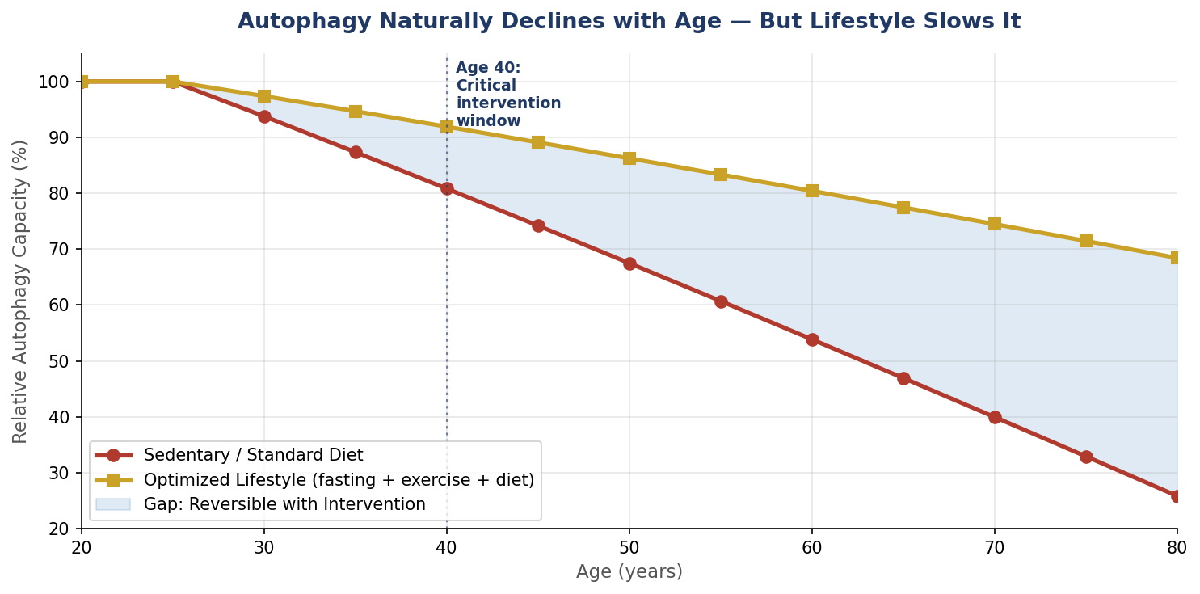
Q2
Why Does Autophagy Naturally Decline After the Age of 40?
The specific biological reasons — and what can slow the decline
Autophagy declines with age due to reduced AMPK signaling, elevated mTOR activity from modern eating patterns, mitochondrial dysfunction, chronic inflammation, and accumulated cellular damage that overwhelms remaining capacity. The critical intervention window is age 40 — where deliberate lifestyle changes can dramatically slow the decline curve.
Dr. John Spencer Ellis | Autophagy & Longevity for Men Over 40 | 10 of 55

Slide 11
Q3
How Does Autophagy Help Repair Cells and Slow the Aging Process?
The specific mechanisms of cellular renewal
Autophagy repairs cells through several specific mechanisms. Macroautophagy engulfs damaged organelles and misfolded proteins in double-membrane vesicles that fuse with lysosomes for breakdown. Mitophagy specifically targets dysfunctional mitochondria — critical because failing mitochondria produce excess reactive oxygen species that damage everything around them. Chaperone-mediated autophagy selectively removes specific damaged proteins tagged for clearance. The recycled amino acids and molecules are then used to build new, healthy cellular components. This constant renewal is what keeps cells functioning across decades. When autophagy fails, damaged material accumulates — driving inflammation, dysfunction, and the specific patterns of decline most men attribute to inevitable aging.
KEY TAKEAWAY
PRACTICAL TIP
RESEARCH INSIGHT
Autophagy is your body's internal repair crew. Keep it working, and cells stay young.
Regular activation through fasting and exercise maintains autophagy capacity across decades.
Cell 2018: Autophagy decline is now recognized as one of the twelve hallmarks of aging.
Dr. John Spencer Ellis | Autophagy & Longevity for Men Over 40 | 11 of 55

Slide 12
Q4
What Is the Relationship Between Autophagy and Longevity?
The direct scientific link between cellular renewal and lifespan
The relationship between autophagy and longevity is direct and well-documented. Animal studies consistently show that enhanced autophagy extends lifespan across species — from yeast to worms to mice. Interventions that activate autophagy (caloric restriction, intermittent fasting, exercise, specific compounds like rapamycin and spermidine) also extend lifespan. Genetic mutations that reduce autophagy shorten lifespan; mutations that enhance autophagy extend it. In humans, autophagy activation is linked to reduced cardiovascular disease, better metabolic health, preserved cognitive function, reduced cancer risk, and improved immune function. Men who maintain autophagy capacity through deliberate lifestyle intervention consistently show better healthspan and longevity markers than sedentary peers on standard diets.
KEY TAKEAWAY
PRACTICAL TIP
RESEARCH INSIGHT
Every animal study on longevity extension involves autophagy activation. The link is unambiguous.
Consider autophagy activation as fundamental to any serious longevity strategy.
Longevity research: rapamycin, caloric restriction, fasting — all extend lifespan through autophagy.
Dr. John Spencer Ellis | Autophagy & Longevity for Men Over 40 | 12 of 55

Slide 13
JSE COACHING
SECTION 02
Fasting Protocols for Autophagy
Questions 5-7: How to fast for maximum cellular renewal
Dr. John Spencer Ellis | Autophagy & Longevity for Men Over 40 | 13 of 55

Slide 14
Q5
How Does Intermittent Fasting Activate Autophagy?
The specific biological mechanism
Intermittent fasting activates autophagy through several interconnected mechanisms. When food intake stops, insulin drops. Low insulin signals cells that resources are scarce, activating AMPK (a cellular energy sensor) and suppressing mTOR (the growth signaling pathway that inhibits autophagy). This dual signal tells cells to shift from growth mode to conservation and cleanup mode. Damaged proteins get recycled for their amino acids. Dysfunctional mitochondria get cleared. Cellular waste gets processed. Additionally, fasting reduces circulating glucose, IGF-1, and inflammatory markers — all of which independently inhibit autophagy when elevated chronically. The longer the fast, the deeper the autophagy activation — up to a plateau around 48-72 hours.
KEY TAKEAWAY
PRACTICAL TIP
RESEARCH INSIGHT
Fasting is the most reliable natural autophagy activator. The biology is well-established.
Start with 14-16 hour daily windows before attempting longer fasts.
Nobel Prize research: fasting activates the same autophagy pathways Ohsumi originally uncovered.
Dr. John Spencer Ellis | Autophagy & Longevity for Men Over 40 | 14 of 55

Slide 15
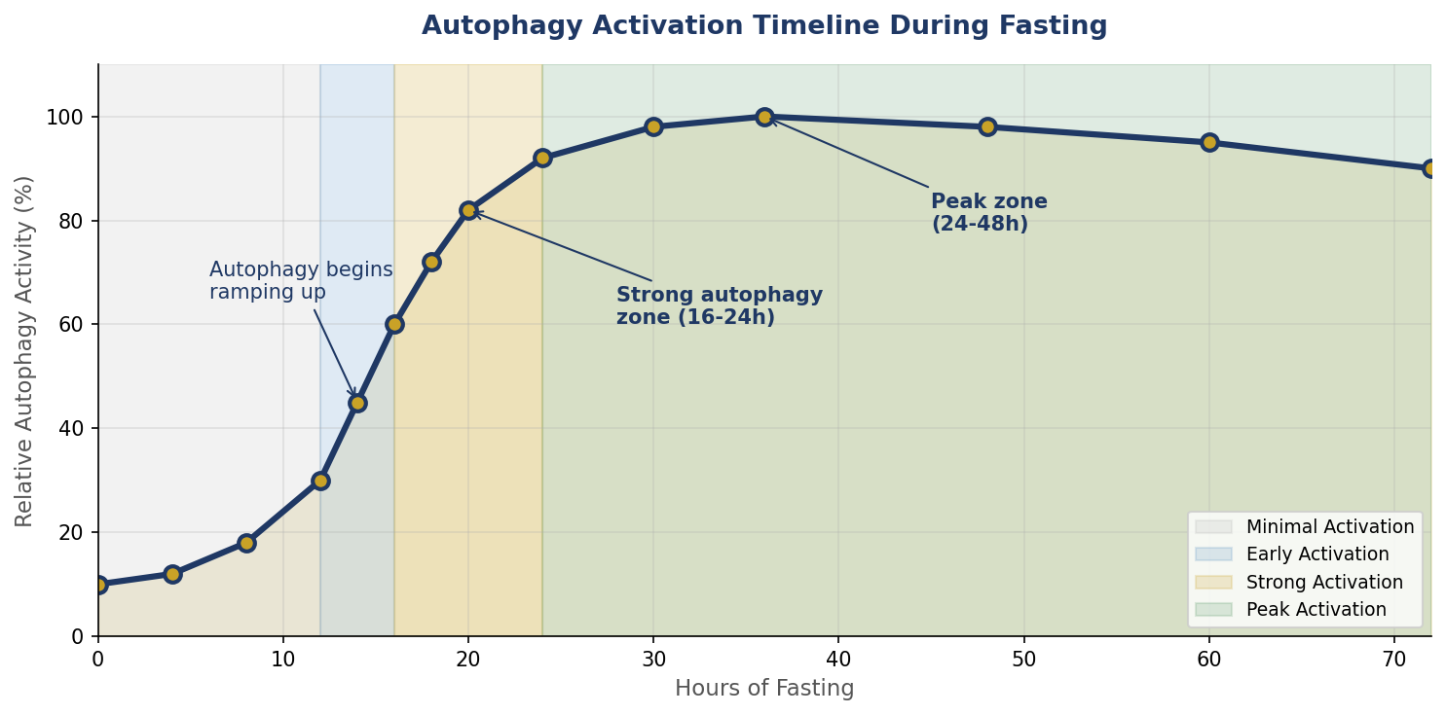
Q6
How Long Do You Need to Fast Before Autophagy Begins?
The specific timeline of cellular renewal during fasting
Autophagy begins ramping up around 12-14 hours of fasting, reaches significant activation by 16-18 hours, peaks strongly between 24-48 hours, and remains elevated up to about 72 hours. For most men, 16-20 hour daily windows produce meaningful benefits without extreme measures. Longer fasts (24-72 hours) done occasionally produce deeper effects.
Dr. John Spencer Ellis | Autophagy & Longevity for Men Over 40 | 15 of 55

Slide 16
Q7
What Are the Best Fasting Methods to Stimulate Autophagy Safely?
The specific protocols with the best risk-benefit profile
The best fasting methods for autophagy in men over 40 include: Time-Restricted Eating (14-16 hour daily windows) — most sustainable, works for most men. 18:6 fasting (18 hours fasting, 6 eating window) — deeper autophagy while still daily. One 24-hour fast weekly — significant autophagy activation, manageable schedule. 5:2 pattern — normal eating 5 days, restricted (500-600 cal) 2 days. Occasional 36-48 hour fasts — deeper cellular renewal, done monthly or quarterly. Extended fasting (72+ hours) — deepest effects but requires medical supervision and preserves muscle poorly in older men. Start with 14-16 hour windows and progress carefully based on how your body responds.
KEY TAKEAWAY
PRACTICAL TIP
RESEARCH INSIGHT
Time-Restricted Eating 14-16 hours is the safest, most sustainable starting point for most men.
Break long fasts with easily-digested foods, not large meals — protects gut and reduces refeeding stress.
Meta-analyses show TRE 14-18 hours produces measurable metabolic benefits with minimal risk.
Dr. John Spencer Ellis | Autophagy & Longevity for Men Over 40 | 16 of 55

Slide 17
JSE COACHING
SECTION 03
Diet, Nutrients & Lifestyle for Autophagy
Questions 8-9: What supports and what inhibits cellular renewal
Dr. John Spencer Ellis | Autophagy & Longevity for Men Over 40 | 17 of 55

Slide 18
Q8
Which Foods, Nutrients, and Lifestyle Habits Support Autophagy?
The specific dietary and lifestyle activators
Specific foods and nutrients activate autophagy through documented mechanisms. Coffee (caffeine and polyphenols) activates autophagy independent of fasting. Green tea (EGCG) triggers autophagy in multiple tissues. Spermidine-rich foods (wheat germ, aged cheese, natto, mushrooms) directly activate autophagy pathways. Curcumin (turmeric) activates autophagy and reduces inflammation. Resveratrol (grapes, red wine in moderation) supports autophagy. Ginger, garlic, and cruciferous vegetables provide autophagy-supporting compounds. Beyond specific foods, lifestyle habits including consistent sleep, regular exercise, sauna use, cold exposure, and stress management all support autophagy activation. The Mediterranean diet pattern with intermittent fasting represents an ideal autophagy-supporting nutrition framework.
KEY TAKEAWAY
PRACTICAL TIP
RESEARCH INSIGHT
You can support autophagy through food and lifestyle even without long fasts.
Add coffee or green tea in the morning during your fasting window for compound benefits.
Nature 2016: Spermidine supplementation extended lifespan in mice via autophagy activation.
Dr. John Spencer Ellis | Autophagy & Longevity for Men Over 40 | 18 of 55

Slide 19
Q9: What Common Habits Can Reduce or Inhibit Autophagy?
The specific behaviors that shut down cellular renewal
Frequent snacking and constant eating throughout the day
High protein consumption every 2-3 hours (elevates mTOR)
Excessive sugar and refined carbohydrate intake
Chronic sleep deprivation (autophagy peaks during sleep)
Sedentary lifestyle with minimal physical activity
Chronic alcohol consumption
Ultra-processed food consumption
Chronic elevated insulin from continuous eating
Persistent chronic stress and elevated cortisol
Overuse of anti-inflammatory medications long-term
Excessive caloric intake even from healthy foods
Dr. John Spencer Ellis | Autophagy & Longevity for Men Over 40 | 19 of 55
Constant grazing that never allows fasting states
Every one of these habits shuts down autophagy. Eliminating them is as important as activating.

Slide 20
JSE COACHING
SECTION 04
Autophagy's Documented Health Benefits
Questions 10-13: What proper autophagy activation actually produces
Dr. John Spencer Ellis | Autophagy & Longevity for Men Over 40 | 20 of 55

Slide 21
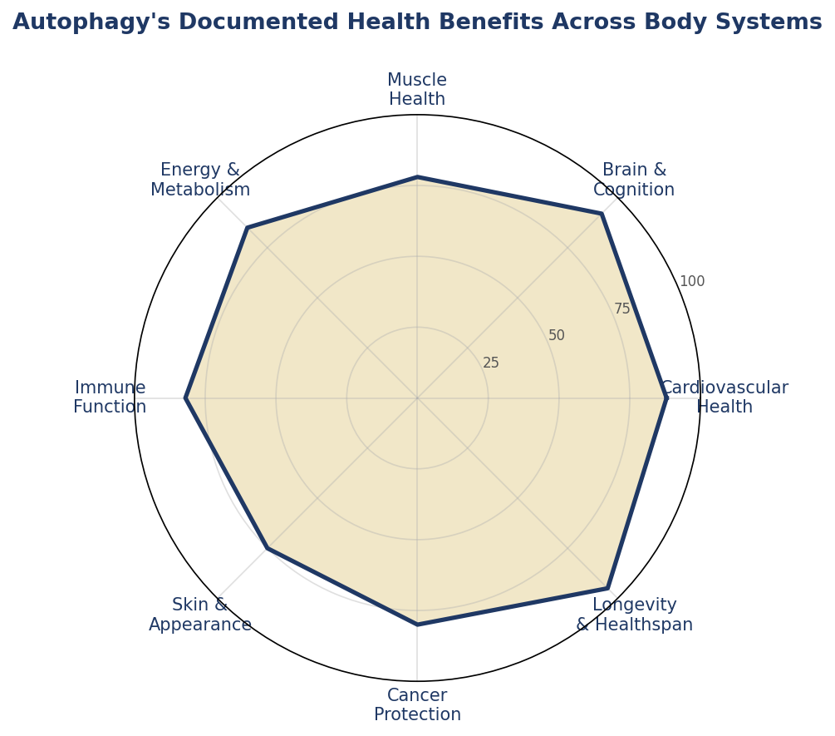
Q10
What Are the Proven Health Benefits of Increasing Autophagy?
The measurable improvements across body systems
Autophagy activation produces measurable benefits across every major body system. Cardiovascular health, brain and cognition, muscle preservation, metabolic function, immune resilience, skin quality, and cancer protection all show documented improvement with sustained autophagy activation. These benefits are why autophagy has become central to longevity science.
Dr. John Spencer Ellis | Autophagy & Longevity for Men Over 40 | 21 of 55

Slide 22
Q11
Can Autophagy Help Reduce the Risk of Heart Disease, Diabetes, and Cancer?
The specific disease prevention documented in research
Autophagy reduces disease risk through multiple mechanisms. For cardiovascular disease: autophagy clears damaged proteins from heart muscle, removes dysfunctional mitochondria that would otherwise drive inflammation, and preserves endothelial function. For type 2 diabetes: autophagy improves insulin sensitivity, clears damaged beta cells in the pancreas, and reduces the chronic inflammation that drives metabolic dysfunction. For cancer: autophagy removes damaged cells before they can become malignant, clears the misfolded proteins that would otherwise accumulate, and supports immune surveillance. However, autophagy's role in established cancer is complex — it can protect tumors once formed. This is why autophagy is best understood as a prevention strategy, not a cancer treatment.
KEY TAKEAWAY
PRACTICAL TIP
RESEARCH INSIGHT
Autophagy is one of the most powerful disease prevention mechanisms in your body.
Focus on autophagy activation for prevention, not as treatment for existing conditions.
American Heart Association research documents autophagy's cardioprotective effects.
Dr. John Spencer Ellis | Autophagy & Longevity for Men Over 40 | 22 of 55

Slide 23
Q12
How Does Autophagy Support Brain Health and Cognitive Function?
The specific brain benefits documented in research
Autophagy is critical for brain health because neurons — unlike most cells — cannot divide to replace damaged versions. Neurons must maintain themselves through continuous internal repair, which is autophagy. When autophagy fails in the brain, misfolded proteins accumulate: beta-amyloid plaques linked to Alzheimer's disease, alpha-synuclein linked to Parkinson's, and tau tangles linked to multiple neurodegenerative conditions. Enhanced autophagy through fasting, exercise, and specific compounds has been documented to improve cognitive function, clear damaged proteins, support neuroplasticity, and reduce risk of dementia. The brain benefits from autophagy show up as sharper thinking, better memory, improved mood, and reduced risk of age-related cognitive decline.
KEY TAKEAWAY
PRACTICAL TIP
RESEARCH INSIGHT
Brain autophagy is not optional — it is the specific process protecting against Alzheimer's and Parkinson's.
Combine morning coffee with fasted exercise for compound autophagy benefits to brain.
Neurology research: enhanced autophagy correlates with reduced neurodegenerative disease risk.
Dr. John Spencer Ellis | Autophagy & Longevity for Men Over 40 | 23 of 55

Slide 24
Q13
Can Autophagy Improve Energy Levels, Muscle Health, and Physical Performance After 40?
The specific physical benefits for aging men
Autophagy improves energy and muscle health through specific mechanisms critical for men over 40. Mitophagy — the specific autophagy of damaged mitochondria — clears the dysfunctional mitochondria that would otherwise produce inefficient energy with excess reactive oxygen species. Replacing failing mitochondria with new ones improves cellular energy production directly. For muscle: autophagy clears damaged muscle proteins and supports the constant turnover that maintains muscle quality. Balanced autophagy (activated but not excessive) supports muscle repair from training while preserving mass. Combined with adequate protein and resistance training, autophagy activation supports the specific pattern of preserved muscle mass and improved energy that men want in their 50s and 60s.
KEY TAKEAWAY
PRACTICAL TIP
RESEARCH INSIGHT
Autophagy supports both muscle preservation and cellular energy — critical for men over 40.
Fasted morning workouts activate autophagy while training. Refuel with protein afterward.
European Journal of Applied Physiology: Fasted exercise increases autophagy markers significantly.
Dr. John Spencer Ellis | Autophagy & Longevity for Men Over 40 | 24 of 55

Slide 25
JSE COACHING
SECTION 05
Exercise & Supplements for Autophagy
Questions 14-15: The additional activators beyond fasting
Dr. John Spencer Ellis | Autophagy & Longevity for Men Over 40 | 25 of 55

Slide 26
Q14
What Role Do Exercise and Strength Training Play in Activating Autophagy?
The specific training approaches that activate cellular renewal
Exercise activates autophagy through multiple pathways independent of fasting. High-intensity interval training (HIIT) triggers strong autophagy response through energy demand and metabolic stress. Endurance exercise activates autophagy in skeletal muscle after 30+ minutes. Resistance training activates autophagy in trained muscle groups, supporting the muscle protein turnover critical for muscle preservation. Fasted training amplifies autophagy — combining exercise with a fasting state produces stronger autophagy activation than either alone. The optimal framework combines strength training 3-4 times weekly, Zone 2 cardio 3-4 hours weekly, and periodic higher-intensity intervals for VO2 max — with fasted morning sessions when possible for men over 40.
KEY TAKEAWAY
PRACTICAL TIP
RESEARCH INSIGHT
Exercise activates autophagy independent of fasting. Combining both amplifies the effect.
Try morning fasted strength training 2-3 times weekly for compound autophagy activation.
Sports Medicine reviews: exercise-induced autophagy is documented across multiple muscle types.
Dr. John Spencer Ellis | Autophagy & Longevity for Men Over 40 | 26 of 55

Slide 27
Q15
Which Supplements May Help Support Healthy Autophagy?
The evidence-based compounds that activate cellular renewal
Several supplements have documented autophagy-activating effects. Spermidine (wheat germ, natto, aged cheese, or supplement form) directly activates autophagy pathways — one of the best-researched autophagy compounds. Resveratrol supports SIRT1 activation and autophagy. Curcumin (from turmeric with piperine for absorption) activates autophagy while reducing inflammation. Berberine may activate AMPK pathways similar to fasting. Green tea extract (EGCG) supports autophagy. Coenzyme Q10 supports mitochondrial function that underlies mitophagy. Magnesium supports overall cellular energy metabolism required for autophagy. Rapamycin is the most powerful autophagy activator but requires prescription and medical oversight due to side effects. Supplements support the framework but do not replace fasting and exercise.
KEY TAKEAWAY
PRACTICAL TIP
RESEARCH INSIGHT
Spermidine, resveratrol, and curcumin have the strongest evidence for supporting autophagy.
Take spermidine or resveratrol during your fasting window for compound activation.
Nature Medicine: Spermidine supplementation extends lifespan through autophagy activation.
Dr. John Spencer Ellis | Autophagy & Longevity for Men Over 40 | 27 of 55

Slide 28
JSE COACHING
SECTION 06
Safety & Cautions
Questions 16-17: Understanding the limits and who should be careful
Dr. John Spencer Ellis | Autophagy & Longevity for Men Over 40 | 28 of 55

Slide 29
Q16
Is It Possible to Have Too Much Autophagy, and What Are the Risks?
The important balance every man should understand
Yes, too much autophagy is theoretically possible and carries specific risks. Excessive autophagy can accelerate muscle loss (particularly problematic for men over 50 already facing sarcopenia). Prolonged extreme fasting can trigger autophagy that exceeds what tissues need for repair, potentially causing cellular self-destruction rather than renewal. In established cancer, autophagy can actually protect tumor cells — one reason why extended fasting is generally not recommended during active cancer treatment. Excessive autophagy from chronic extreme caloric restriction can suppress reproductive function, immune function, and hormone production in men. The goal is optimal autophagy activation through moderate, sustainable protocols — not maximum activation through extreme measures. Most men benefit from 14-24 hour fasting windows, not 5-7 day water fasts.
KEY TAKEAWAY
PRACTICAL TIP
RESEARCH INSIGHT
More is not always better with autophagy. Sustainable moderate activation beats extreme protocols.
Stick with 14-24 hour fasting windows. Longer fasts should be occasional, not routine.
Cell 2019: Excessive autophagy without balance can accelerate muscle loss in older adults.
Dr. John Spencer Ellis | Autophagy & Longevity for Men Over 40 | 29 of 55

Slide 30
Q17: Who Should Avoid Extended Fasting or Consult a Doctor First?
The specific populations requiring medical guidance
Men with diabetes on insulin or medications affecting blood sugar
Men with active eating disorders or eating disorder history
Men on medications requiring food (many blood pressure, thyroid, seizure meds)
Men with active cancer or undergoing cancer treatment
Men significantly underweight or with body fat under 10%
Men with adrenal insufficiency or severe cortisol dysfunction
Men with chronic kidney disease (protein and hydration concerns)
Men with severe cardiovascular disease without medical clearance
Men experiencing significant chronic stress or burnout
Men over 65 without prior fasting experience or medical guidance
Men with gallbladder disease or history of gallstones
Dr. John Spencer Ellis | Autophagy & Longevity for Men Over 40 | 30 of 55
Anyone with symptoms of dizziness, fainting, or extreme fatigue during fasting
Work with a qualified physician before extended fasting if you fit any of these categories.

Slide 31
JSE COACHING
SECTION 07
Practical Application for Men Over 40
Questions 18-19: Building sustainable autophagy into your life
Dr. John Spencer Ellis | Autophagy & Longevity for Men Over 40 | 31 of 55

Slide 32
Q18
How Can Men Over 40 Incorporate Autophagy Into a Sustainable Longevity Plan?
The specific integrated framework for lasting results
Building sustainable autophagy activation into a men's longevity plan requires integration rather than extreme measures. Start with daily 14-16 hour time-restricted eating (skip breakfast or eat dinner earlier). Add 2-3 fasted morning workouts weekly, combining strength training and Zone 2 cardio. Include autophagy-supporting foods daily: morning coffee or green tea, curcumin, spermidine sources. Progress to occasional 20-24 hour fasts monthly. Combine with quality sleep (7-9 hours nightly) which supports autophagy independently. Add hormetic stressors: sauna 2-4x weekly and cold exposure. Track energy, sleep quality, and body composition to calibrate. This integrated approach produces sustainable autophagy activation without the risks of extreme protocols.
KEY TAKEAWAY
PRACTICAL TIP
RESEARCH INSIGHT
Integration produces sustainable results. Extreme protocols produce short-term wins followed by rebound.
Build the framework across 12 weeks — one habit added every 2 weeks — for sustainable change.
Cell Metabolism research: sustained moderate fasting produces better long-term outcomes than extreme protocols.
Dr. John Spencer Ellis | Autophagy & Longevity for Men Over 40 | 32 of 55

Slide 33
Q19: What Daily Habits Can Help Maximize Autophagy for Lifelong Health?
The specific practices to embed into every day
Compress eating window to 8-10 hours daily (14-16 hour fast)
Consume morning coffee or green tea during fasting window
Train 3-4 times weekly, ideally 2-3 sessions fasted
Include spermidine-rich foods 3-4x weekly (wheat germ, natto, aged cheese)
Add curcumin/turmeric to at least one meal daily
Sleep 7-9 hours consistently (autophagy peaks during sleep)
Include 2-4 sauna sessions weekly if accessible
Add cold exposure 2-3x weekly (cold shower, plunge)
Minimize ultra-processed foods and refined sugars
Avoid constant snacking — allow gaps between meals
Include cruciferous vegetables and berries daily
Dr. John Spencer Ellis | Autophagy & Longevity for Men Over 40 | 33 of 55
One weekly 24-hour fast when schedule permits
Consistency across months compounds into dramatic autophagy activation and healthspan extension.

Slide 34
JSE COACHING
SECTION 08
Essential Takeaways
Question 20: The core message for extending healthspan
Dr. John Spencer Ellis | Autophagy & Longevity for Men Over 40 | 34 of 55

Slide 35
Q20
What Are the Most Important Takeaways About Using Autophagy to Extend Lifespan and Healthspan?
The essential messages every man over 40 should remember
The core takeaways about autophagy for men over 40 are as follows. Autophagy is one of the most consequential biological processes for healthy aging — Nobel Prize-worthy science, not fringe theory. It naturally declines after 40 but responds dramatically to lifestyle intervention. Intermittent fasting (14-24 hour windows) is the most reliable natural activator. Exercise activates autophagy independently, and combining fasted exercise amplifies effects. Specific foods (coffee, tea, spermidine sources, curcumin) support activation. Sleep quality matters — autophagy peaks during sleep. Balance is essential — extreme protocols risk muscle loss and other issues. Integration into a sustainable longevity plan produces the best results. Work with qualified coaching to calibrate the specific approach for your biology and goals.
KEY TAKEAWAY
PRACTICAL TIP
RESEARCH INSIGHT
Autophagy is measurable, activatable, and essential. Take it seriously as a longevity intervention.
Start with 16-hour daily fasting windows and 2 fasted workouts weekly for immediate benefits.
Meta-analyses consistently document autophagy activation as central to healthy aging interventions.
Dr. John Spencer Ellis | Autophagy & Longevity for Men Over 40 | 35 of 55

Slide 36
JSE COACHING
SECTION 09
Original Autophagy Frameworks
The visual systems that organize the complete approach
Dr. John Spencer Ellis | Autophagy & Longevity for Men Over 40 | 36 of 55

Slide 37
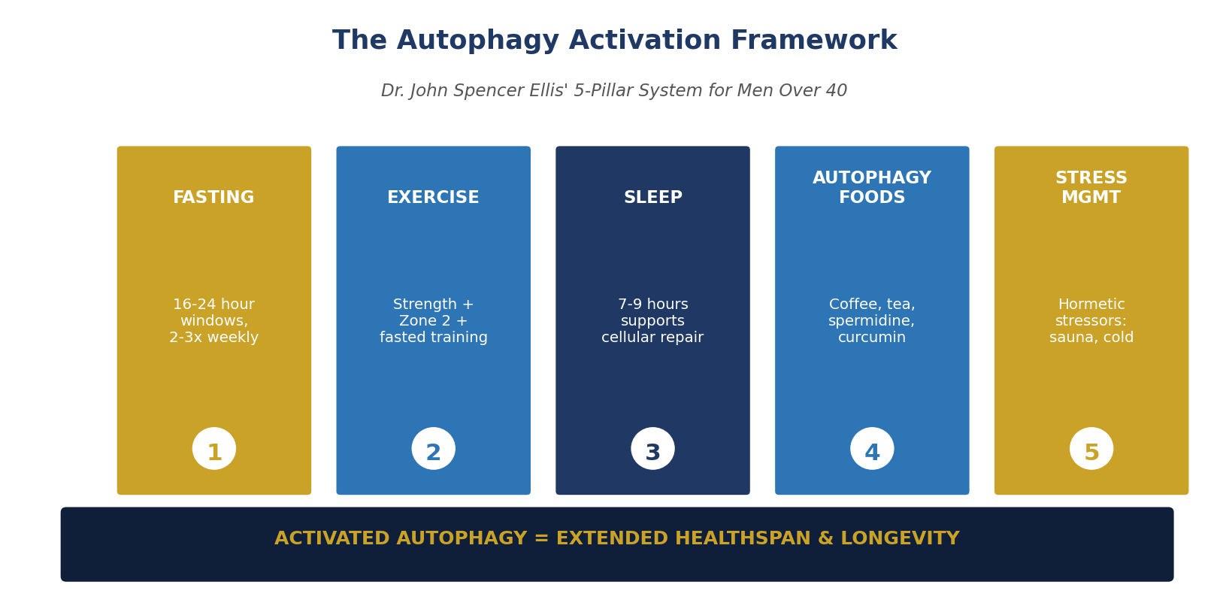
The Autophagy Activation Framework
Dr. Ellis' 5-pillar system for men over 40
The Autophagy Activation Framework organizes the five most powerful autophagy activators into one integrated system: Fasting, Exercise, Sleep, Autophagy-supporting Foods, and Hormetic Stress. Each pillar independently activates autophagy. Combined, they produce sustained cellular renewal across decades.
Dr. John Spencer Ellis | Autophagy & Longevity for Men Over 40 | 37 of 55

Slide 38
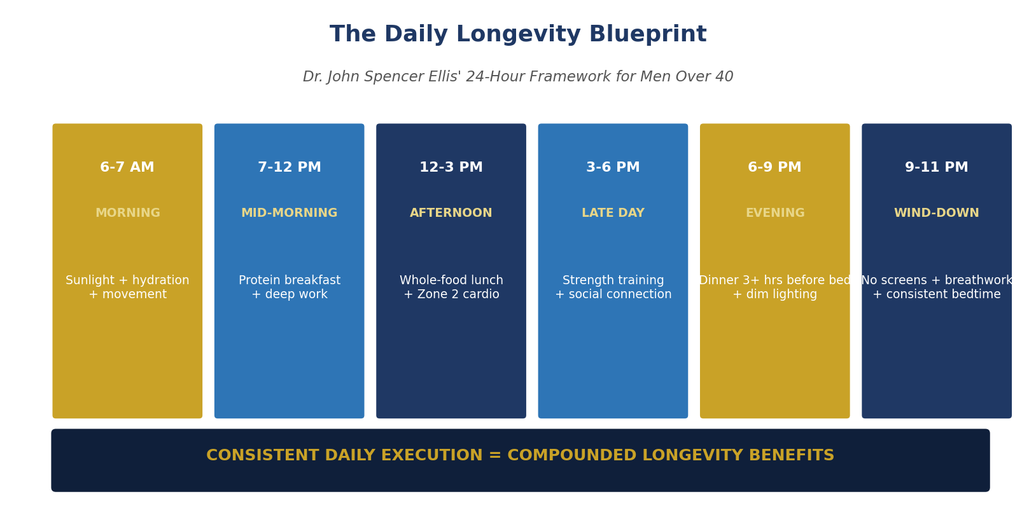
The Daily Longevity Blueprint
Dr. Ellis' 24-hour framework integrating autophagy activation
The Daily Longevity Blueprint translates the autophagy framework into a specific 24-hour structure. Six defined phases across the day support circadian rhythm, hormone production, autophagy activation, physical performance, and stress management as one integrated system.
Dr. John Spencer Ellis | Autophagy & Longevity for Men Over 40 | 38 of 55

Slide 39
JSE COACHING
SECTION 10
Practical Implementation
From knowledge to consistent daily practice
Dr. John Spencer Ellis | Autophagy & Longevity for Men Over 40 | 39 of 55

Slide 40
Common Mistakes Men Make with Autophagy
The specific errors that undermine cellular renewal
Jumping into extended fasting without building tolerance
Fasting so aggressively that muscle loss becomes significant
Eating protein constantly, keeping mTOR elevated all day
Assuming supplements can replace fasting and exercise
Ignoring sleep quality (autophagy peaks during sleep)
Extreme fasting during high-stress life periods
Not breaking fasts appropriately — large meals cause distress
Adding autophagy protocols to already-inadequate baseline nutrition
Attempting extreme fasting with medical conditions warranting caution
Focusing on maximum autophagy rather than sustainable activation
The right approach is moderate, sustainable, and integrated — not extreme.
Dr. John Spencer Ellis | Autophagy & Longevity for Men Over 40 | 40 of 55

Slide 41
The 90-Day Autophagy Implementation Plan
Systematic progression for sustainable results
Weeks 1-4: Foundation. Establish consistent 12-14 hour daily eating window. Add 2 fasted morning walks weekly. Begin morning coffee during fasting window. Include curcumin at one meal daily. Establish consistent sleep schedule.
Weeks 5-8: Progression. Extend eating window compression to 14-16 hours. Add 2 fasted strength training sessions weekly. Include spermidine-rich foods 3x weekly. Add 2 sauna sessions weekly. Improve sleep environment and consistency.
Weeks 9-12: Integration. Progress to 16-18 hour daily windows. Attempt one 24-hour fast if body responds well. Refine training with fasted Zone 2 cardio. Evaluate results and adjust for sustainability across the second half of life.
Dr. John Spencer Ellis | Autophagy & Longevity for Men Over 40 | 41 of 55

Slide 42
JSE COACHING
SECTION 11
Dr. Ellis' Coaching Programs & Resources
The path forward with qualified coaching support
Dr. John Spencer Ellis | Autophagy & Longevity for Men Over 40 | 42 of 55

Slide 43
The Men's Health and Longevity Coaching Program
Where autophagy activation integrates into complete longevity work
Program Overview
A 90-day fully personalized one-on-one coaching engagement integrating hormonal optimization, sleep architecture, structured strength and cardiovascular training, anti-inflammatory nutrition, autophagy activation protocols, and deliberate stress management. Calibrated to each client's specific biology, current bloodwork, lifestyle, and goals.
How Autophagy Fits Into the Program
Autophagy activation is calibrated to each client's specific biology, training schedule, and lifestyle. The specific fasting protocol, exercise timing, and nutrition framework are personalized rather than one-size-fits-all. This produces sustainable results without the muscle loss and burnout that plagues generic fasting protocols in men over 40.
What Every Client Receives
12 weekly sessions with Dr. Ellis, comprehensive intake and bloodwork, custom action plan, extensive video modules, resource library, and sustained accountability.
Dr. John Spencer Ellis | Autophagy & Longevity for Men Over 40 | 43 of 55

Slide 44
The Escape the Rat Race Coaching Program
For men redesigning lifestyle to support longevity work
Program Overview
For accomplished men whose corporate careers have contributed to their health decline. This program helps design deliberate transitions from corporate careers into freedom-based lifestyles built around consulting, coaching, business ownership, or portfolio careers — removing the chronic stress that undermines autophagy and biological restoration.
Why This Matters for Autophagy
Chronic corporate stress elevates cortisol, which directly suppresses autophagy. Working 55+ hours weekly makes proper fasting timing nearly impossible. Constant travel disrupts circadian rhythm that supports autophagy. Redesigning the lifestyle that damaged autophagy allows the framework to actually work. This program addresses exactly that dimension of the men's longevity equation.
Dr. John Spencer Ellis | Autophagy & Longevity for Men Over 40 | 44 of 55

Slide 45
The Combined Coaching Option
Both programs together for the complete transformation
Either coaching program can be engaged independently based on which dimension is the primary concern. For men who recognize that both biology and lifestyle require attention, Dr. Ellis offers the option to combine both programs into a single coordinated coaching engagement.
Why Combined Produces the Best Results
1
Restored autophagy enables lifestyle transition
Improved energy and cognition support the professional shift
2
Redesigned lifestyle sustains autophagy activation
Removes chronic stress that would otherwise suppress cellular renewal
3
Both dimensions reinforce each other continuously
The integrated framework produces compounding results
4
One coordinated engagement rather than sequential programs
Efficient use of time and coaching resources
5
Contact Dr. Ellis directly to discuss combined option
Customized structure discussed during initial consultation
Dr. John Spencer Ellis | Autophagy & Longevity for Men Over 40 | 45 of 55

Slide 46
Additional Educational Resources
Where to learn more about Dr. Ellis' work
Main Website: https://johnspencerellis.com
The primary hub for Dr. Ellis' work and coaching
Detailed Biography: https://johnspencerellis.com/about
Complete background and credentials
Diet Guru: https://dietguru.com/
Nutrition-focused platform
Diet Guru Men 40+: https://dietguru.com/health-coaching-for-men-age-40-and-over/
Specific coaching content for men over 40
Substack Newsletter: https://johnspencerellis.substack.com/
Regular longevity insights and articles
LinkedIn Company Page: https://www.linkedin.com/company/john-spencer-ellis-mens-longevity-coach/
Professional updates on men's longevity coaching
YouTube Channel: https://www.youtube.com/@coachjohnspencerellis
Video content on longevity, coaching, and men's health
Instagram: https://instagram.com/johnspencerellis
Daily insights and quick tips
Dr. John Spencer Ellis | Autophagy & Longevity for Men Over 40 | 46 of 55

Slide 47
Scientific References
The peer-reviewed research supporting this framework
• Ohsumi Y. (2016 Nobel Prize). Autophagy discovery and molecular mechanisms.
• Cell (2018). Hallmarks of Aging: An Expanding Universe (autophagy as key hallmark).
• Nature Medicine (2016). Spermidine supplementation extends lifespan through autophagy.
• Cell Metabolism (2019). Time-restricted eating and metabolic outcomes.
• Nature (2020). Rapamycin, autophagy, and longevity across species.
• European Journal of Applied Physiology. Fasted exercise and autophagy markers.
• American Journal of Cardiology. Autophagy in cardiovascular disease prevention.
• Journal of Neurology. Autophagy dysfunction in neurodegenerative disease.
• Autophagy Journal (multiple). Intermittent fasting and cellular renewal.
• The Lancet PURE study. Grip strength and mortality across 139,000 participants.
• JAMA (2011). Sleep restriction and testosterone in healthy young men.
• Sports Medicine. Exercise-induced autophagy across muscle types.
Dr. John Spencer Ellis | Autophagy & Longevity for Men Over 40 | 47 of 55

Slide 48
Key Takeaways: The Essential Autophagy Message
What every man over 40 should remember
Autophagy is Nobel Prize-worthy science, not fringe theory
It naturally declines after 40 but responds to lifestyle intervention
Intermittent fasting (14-24 hours) is the most reliable natural activator
Exercise independently activates autophagy — combined with fasting amplifies
Sleep quality matters — autophagy peaks during sleep
Specific foods support activation: coffee, tea, spermidine, curcumin
Balance is essential — extreme protocols risk muscle loss
Integration into sustainable framework beats extreme measures
The 40s and 50s are the critical intervention window
Qualified coaching accelerates results and prevents common mistakes
The framework is proven. The transformation is measurable. Begin the specific work today.
Dr. John Spencer Ellis | Autophagy & Longevity for Men Over 40 | 48 of 55

Slide 49
Your Next Steps After This Presentation
How to translate education into action
Immediate next steps: Start with 14-hour daily fasting window (skip breakfast or eat dinner earlier). Add morning coffee or green tea during fasting window. Include one fasted morning walk this week. Track energy, hunger, and sleep quality for two weeks to establish baseline response.
Within 30 days: Progress to 16-hour daily windows if body responds well. Add fasted morning strength training 2x weekly. Include spermidine-rich foods 3x weekly. Add sauna or cold exposure 2x weekly. Consider working with qualified coaching for personalized calibration.
The specific transformation is available to any man willing to do the specific work.
Dr. John Spencer Ellis | Autophagy & Longevity for Men Over 40 | 49 of 55

Slide 50
How to Measure Autophagy Progress
The specific metrics that document transformation
Direct autophagy measurement remains difficult clinically, but proxies indicate progress. Objective markers: fasting insulin, HOMA-IR (insulin sensitivity), hs-CRP (inflammation), HbA1c, biological age testing (TruDiagnostic, GlycanAge), body composition changes, VO2 max improvement. These document measurable transformation across 90 days to 12 months.
Functional metrics: sustained energy across the day, sleep quality, cognitive sharpness, physical performance in training, faster recovery from workouts, improved skin quality, and reduced cravings. These document the subjective improvement that men and their partners notice within weeks.
Track objective markers quarterly. Track functional metrics weekly. Adjust based on data.
Dr. John Spencer Ellis | Autophagy & Longevity for Men Over 40 | 50 of 55

Slide 51
Why Work with Dr. John Spencer Ellis on Autophagy
The specific expertise that accelerates results
Personal Trainer Hall of Fame inductee — highest industry recognition
Doctor of Education plus doctoral-level naturopathic studies
33 years of documented men's health coaching experience
15+ professional certifications across every dimension
Personally applies autophagy protocols at age 57
Extensive experience calibrating fasting protocols to individual biology
Work has reached men in more than 65 countries
7-time bestselling author on health, wellness, and longevity
Ironman finisher who understands recovery and performance
Personal experience of career transition and health optimization
Autophagy protocols require personalization. Working with qualified coaching prevents costly mistakes.
Dr. John Spencer Ellis | Autophagy & Longevity for Men Over 40 | 51 of 55

Slide 52
Dr. Ellis in the Media
Documented coverage from major outlets
• MSN - Restoring Health, Appearance, Confidence: https://www.msn.com/en-xl/news/other/dr-john-spencer-ellis-helps-men-in-their-50s-escape-the-corporate-rat-race-while-restoring-their-health-appearance-and-confidence/ar-AA270tH8
• USA Today - Coaching Program Launch: https://www.usatoday.com/press-release/story/35880/dr-john-spencer-ellis-launches-mens-health-and-longevity-coaching-program-for-men-over-40/
• Yahoo Finance - Comprehensive Longevity Coaching: https://finance.yahoo.com/healthcare/articles/dr-john-spencer-ellis-launches-115500727.html
• Business Insider - Longevity Coaching System: https://markets.businessinsider.com/news/stocks/dr-john-spencer-ellis-launches-men-s-longevity-coaching-system-drawing-on-three-decades-of-expertise-in-health-fitness-wellness-and-aesthetics-1036280892
• Time Business News - Chronic Inflammation: https://timebusinessnews.com/dr-john-spencer-ellis-why-chronic-inflammation-is-the-hidden-driver-behind-what-most-men-blame-on-aging/
• 1883 Magazine - Restoring Health: https://1883magazine.com/dr-john-spencer-ellis-helps-men-in-their-50s-escape-the-corporate-rat-race-while-restoring-their-health-appearance-and-confidence/
• USA Wire - Leading Men's Longevity Expert: https://usawire.com/dr-john-spencer-ellis-leading-mens-longevity-expert-launches-personalized-mens-health/
• AP News - Men's Longevity Coaching: https://apnews.com/press-release/access-newswire/press-release-608b6a906a37f8b2fad8fa54b4e81c3f
Dr. John Spencer Ellis | Autophagy & Longevity for Men Over 40 | 52 of 55

Slide 53
What Dr. Ellis' Coached Clients Achieve
The measurable transformation the framework produces
Men who complete Dr. Ellis' 90-day Men's Health and Longevity Coaching Program with autophagy protocols integrated typically produce measurable transformation across every relevant metric: improved insulin sensitivity, reduced hs-CRP, restored energy across the day, better sleep quality, improved body composition, sharper cognition, faster training recovery, and the specific physical presence and vitality that partners, colleagues, and the men themselves notice within weeks.
The framework works because autophagy integrates with sleep optimization, hormone support, structured training, and stress management as one system rather than isolated interventions. Restored cellular renewal supports every other longevity dimension. This is the specific insight that separates coached clients from self-directed effort.
Integration produces transformation. Isolation produces partial results.
Dr. John Spencer Ellis | Autophagy & Longevity for Men Over 40 | 53 of 55

Slide 54
The Complete Autophagy Framework Summarized
Everything covered in one final overview
Autophagy is essential cellular renewal — Nobel Prize science
It declines after 40 but responds dramatically to intervention
Fasting 14-24 hours activates autophagy reliably
Peak autophagy activation occurs at 16-48 hours of fasting
Exercise independently activates autophagy
Fasted training amplifies autophagy activation
Specific foods support activation: coffee, tea, spermidine, curcumin
Sleep quality determines autophagy capacity
Balance matters — extreme protocols risk muscle loss
Integration into sustainable framework produces best results
The framework is proven. The transformation is available. Begin today.
Dr. John Spencer Ellis | Autophagy & Longevity for Men Over 40 | 54 of 55

Slide 55
JSE COACHING
BEGIN YOUR AUTOPHAGY & LONGEVITY WORK TODAY
Work with Dr. John Spencer Ellis
Leading Men's Longevity Expert | 33 Years of Experience | 65+ Countries
Men's Health and Longevity Coaching
Escape the Rat Race Coaching
Autophagy protocols integrated into 90-day program
Redesign lifestyle to support autophagy
johnspencerellis.com/health-longevity-aesthetic-optimization-for-men-40/
johnspencerellis.com/pick-my-brain-2/
Combined Program Option Available on Request
Contact Dr. Ellis directly to discuss combining both programs into one coordinated engagement.
Learn More
Main Website: https://johnspencerellis.com
About Bio: https://johnspencerellis.com/about
Diet Guru: https://dietguru.com/
Dr. John Spencer Ellis | 2780 S. Jones Blvd, Ste 200-3464 | Las Vegas, NV 89146 | (480) 382-2464
At age 57, Dr. Ellis practices exactly what he teaches. The framework is proven. Begin today.

